Slide 1
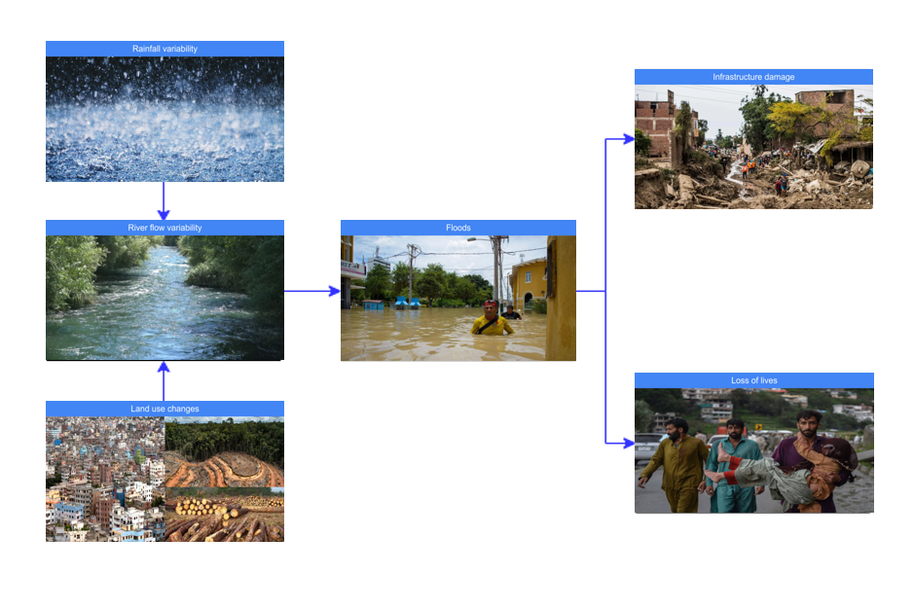
Fresk structure - Group 1

Slide 2
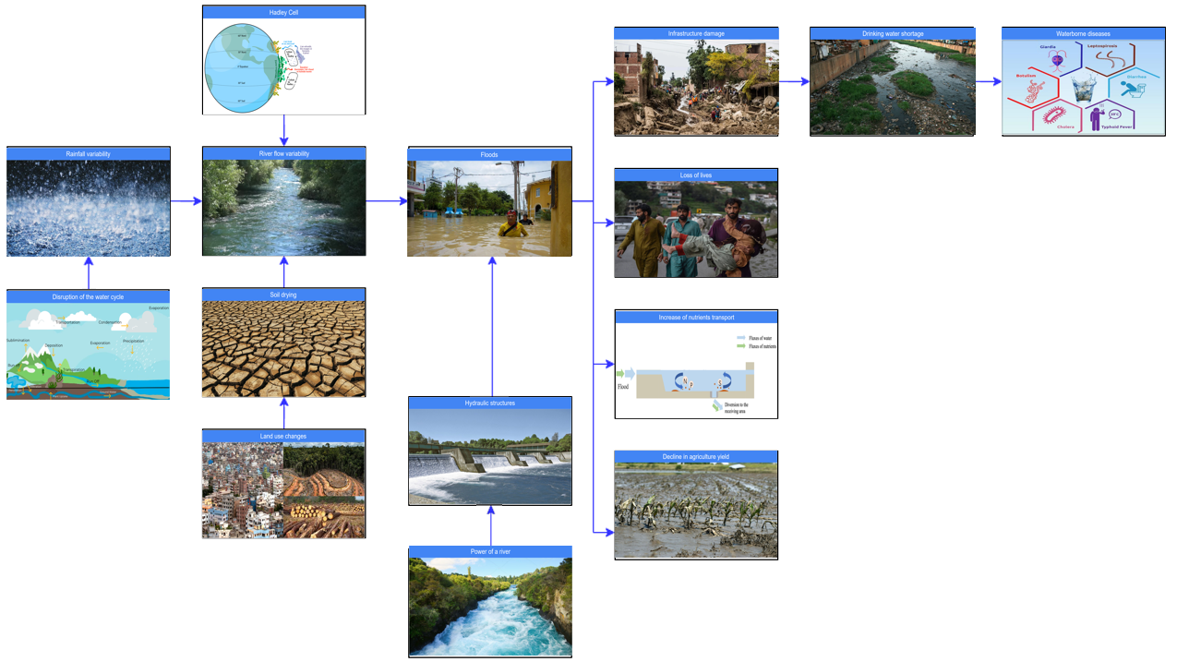
Fresk structure - Group 2

Slide 3
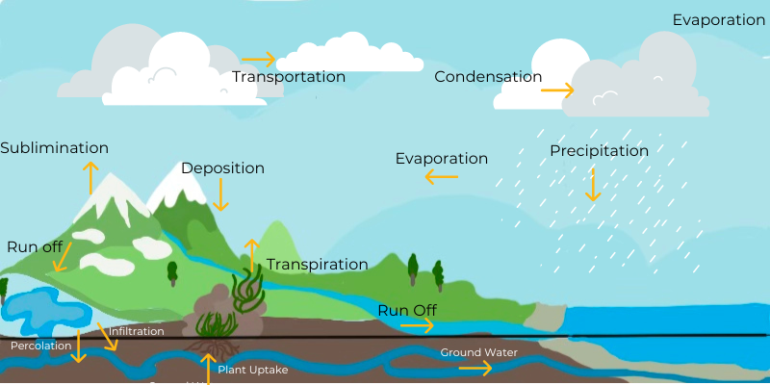
Disruption of the water cycle

Slide 4
Disruption of the water cycle
Changes in the way water naturally moves through the environment, which can be caused by human activities like pollution, changes in land use, and climate change. These changes can affect the amount and quality of water available for people and ecosystems. Understanding the causes and impacts of disruption of the water cycle is important for managing and protecting our water resources.
1

Slide 5
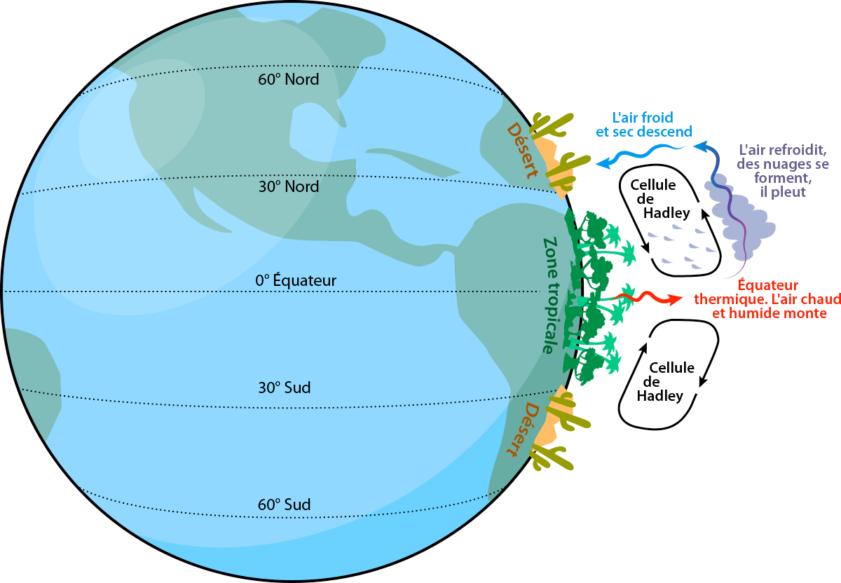
Hadley Cell

Slide 6
Hadley Cell
The Hadley cell is an atmospheric circulation pattern that moves warm, moist air from the equator to higher latitudes and cooler, drier air back to the equator. It helps to create weather patterns and causes the formation of deserts. The Hadley cell is an important part of the Earth's climate system that regulates global temperatures and weather patterns.
2

Slide 7
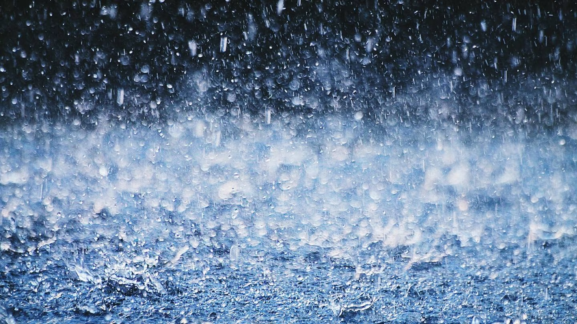
Rainfall variability

Slide 8
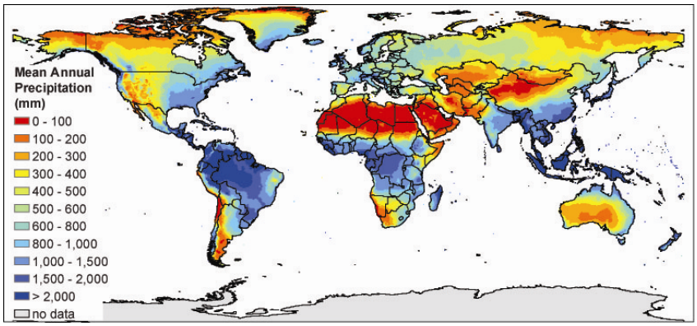
Rainfall variability
Rainfall variability is the fluctuations in precipitation over a particular region and time period, caused by a variety of natural and human factors, including climate change, oceanic processes, land surface changes, atmospheric dynamics, and human activities.
3

Slide 9
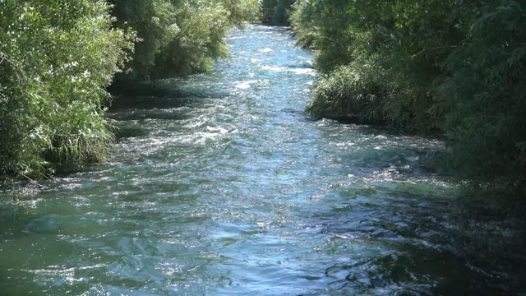
River flow variability

Slide 10
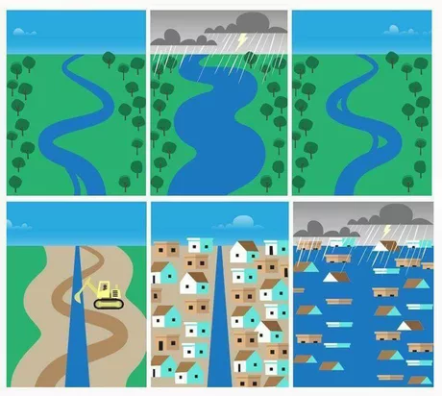
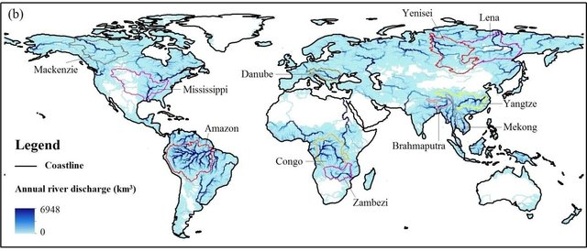
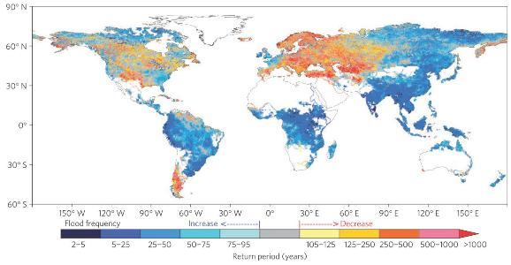
River flow variability
River flow variability refers to the natural fluctuations in the amount and timing of water flowing in a river.
River flow variability can be affected by higher rainfall variability that can lead to more frequent and severe floods, as more water is transported downstream in shorter periods. It can also be affected by human activities such as land use changes.
4
Projected change in flood frequency

Slide 11
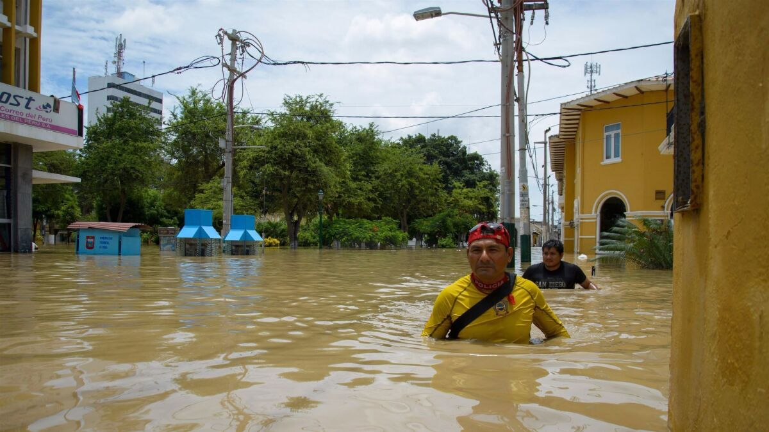
Floods

Slide 12
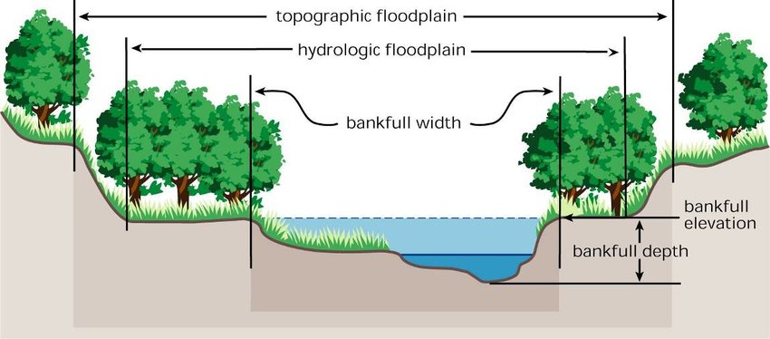
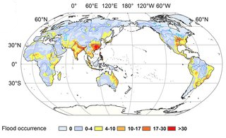
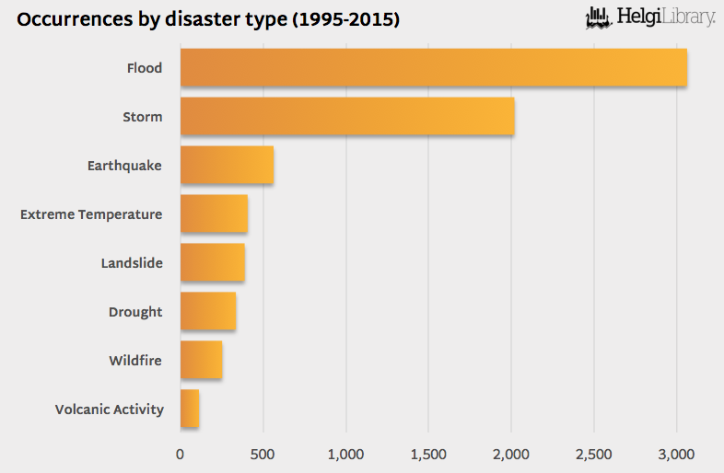
Floods
Floods are defined as any water level above the bankfull stage of a river is considered a flood.
Floods are considered to be the most common natural hazard in the world
There are several factors that affect the occurrence and severity of floods: rainfall variability, topography, land use changes, infrastructure, rainfall variability.
5

Slide 13
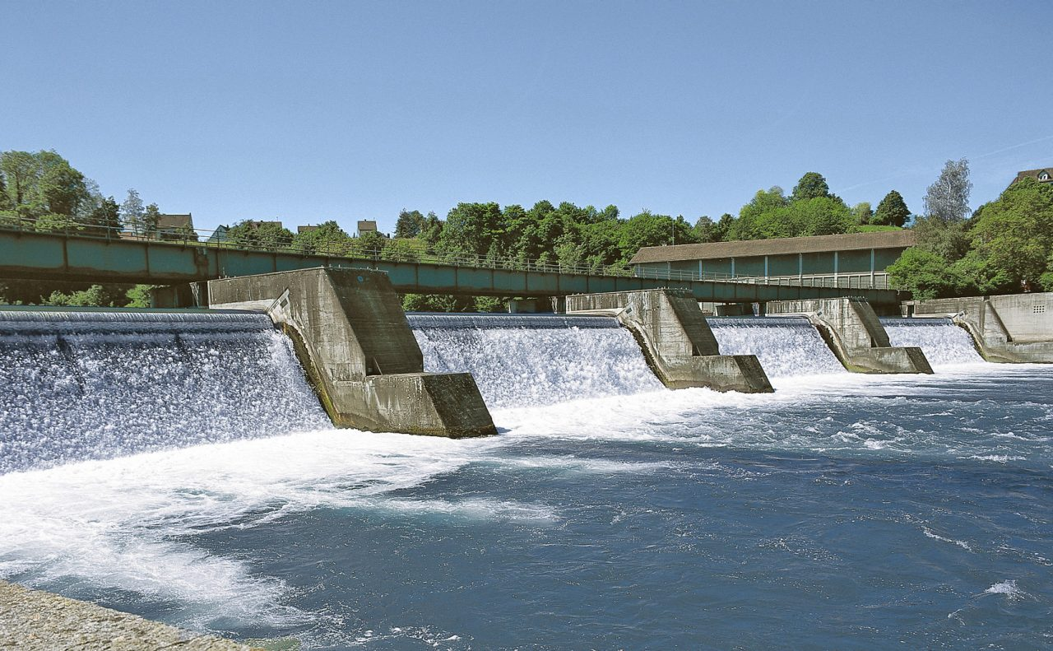
Hydraulic structures

Slide 14
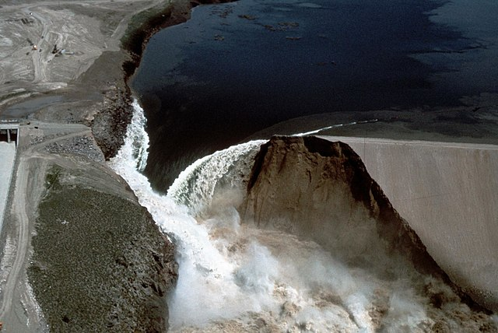
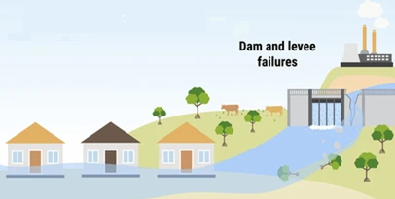
Hydraulic structures are designed to manage water resources and control water flow. However unexpected events, accidents, or meteorological phenomena can impact on the structure and alter the occurrence and severity of floods.
Hydraulic structures
Dams are structures built across rivers to hold back water and create reservoirs for various purposes, such as hydroelectric power generation, irrigation, and flood control.
Levees, on the other hand, are earthen embankments constructed alongside rivers and other bodies of water to contain floodwaters and prevent flooding in adjacent areas
6

Slide 15
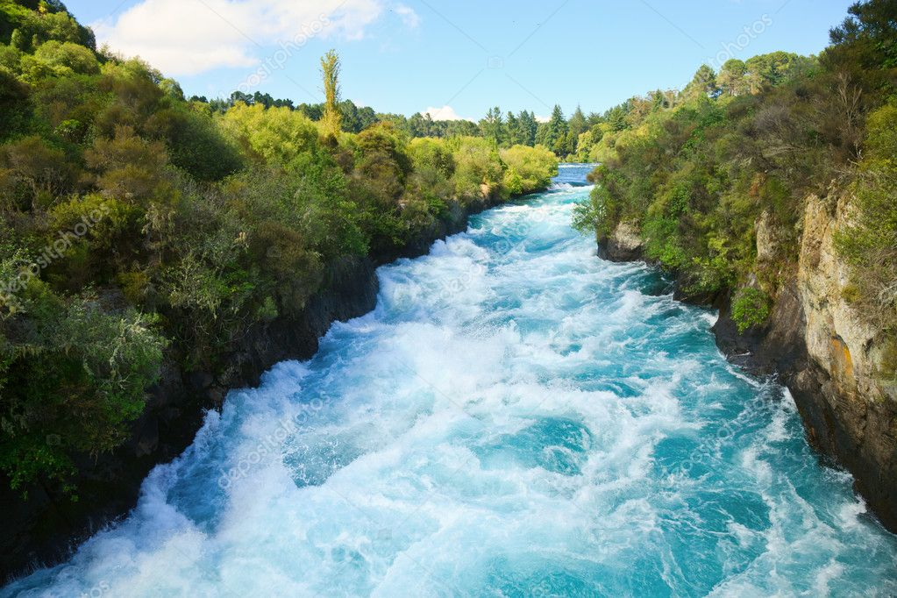
Power of a river

Slide 16


Power of a river
The power of a river is the amount of energy that it possesses due to its volume, velocity, and gradient. This power can be harnessed for various purposes, such as generating electricity, providing irrigation, or supporting transportation. However, during floods, the power of a river can become a destructive force, as the high volume and velocity of the water can cause significant erosion, damage to infrastructure, and loss of life. Floods can also cause sediment and debris to be transported downstream, further increasing the power of the river and exacerbating the damage.
Stream power
p : the water density
b : the width of the channel
S : the section of the channel
Q : the water flow
g : acceleration due to gravity
Unit Stream power
7

Slide 17
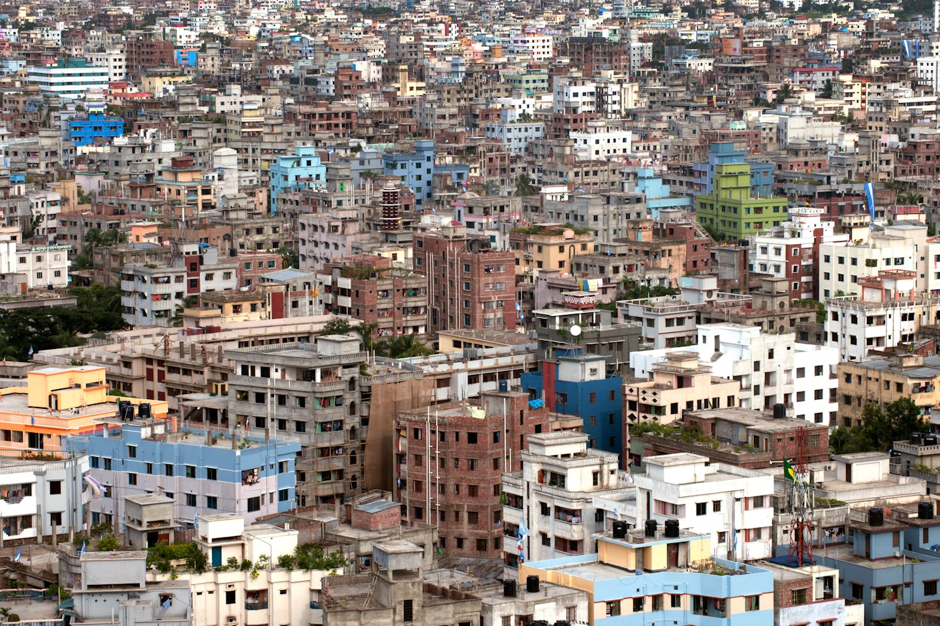
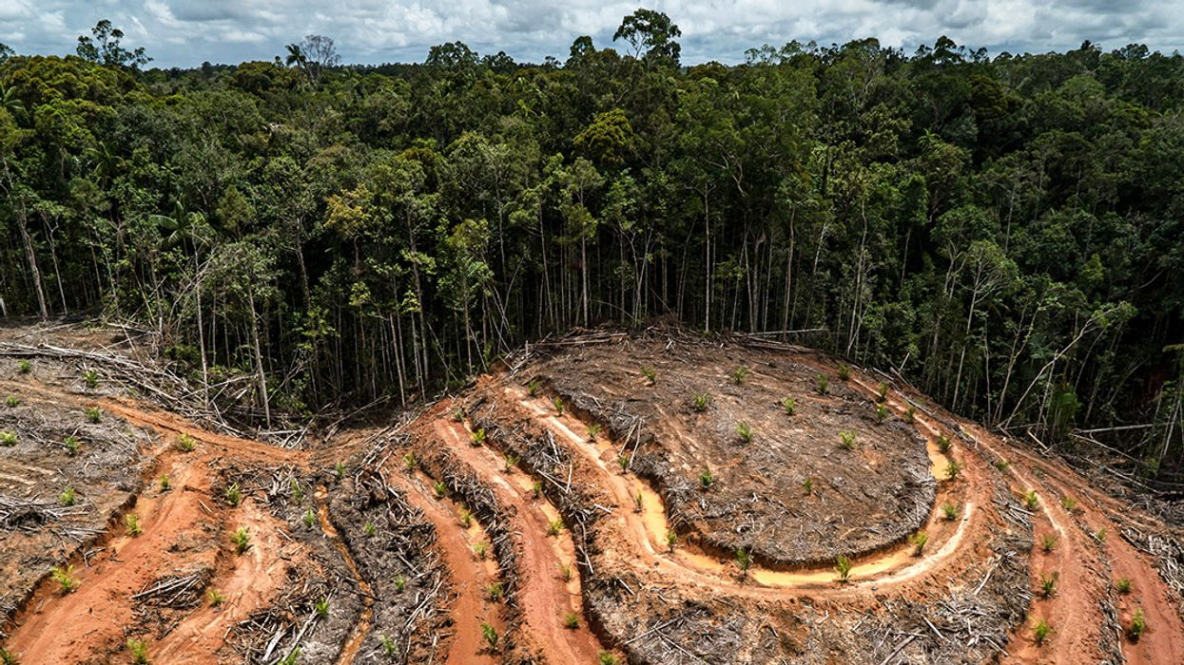
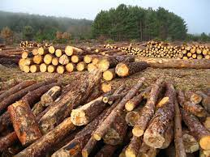
Land use changes

Slide 18
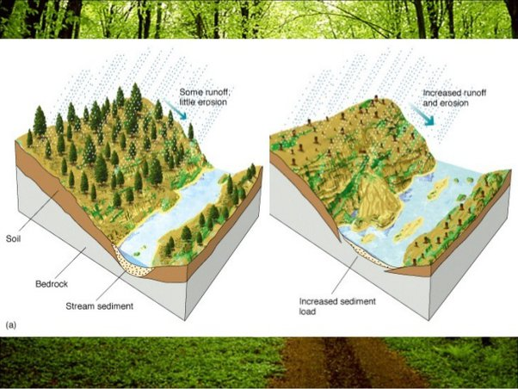
Land use changes
Land use changes refer to the modification or alteration of the use of land by human activities, which can include urbanization, deforestation, agriculture, mining, and other forms of land development. These changes can alter the water cycle, increasing the risk of floods.
For example: Deforestation can increase which can cause the river bed to become shallower and narrower, reducing the capacity of the river and increasing the likelihood of flooding .
8

Slide 19
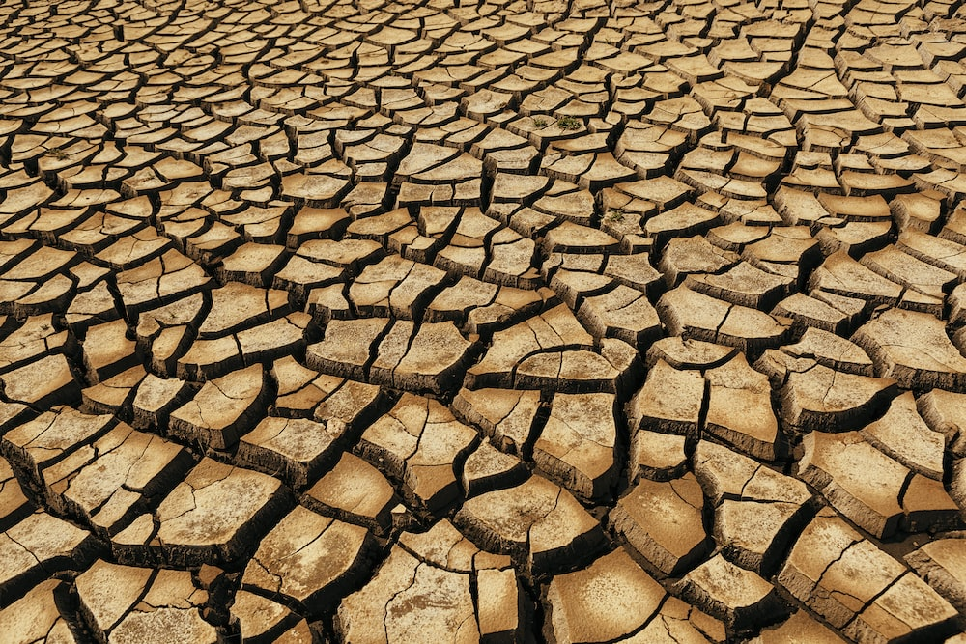
Soil drying

Slide 20
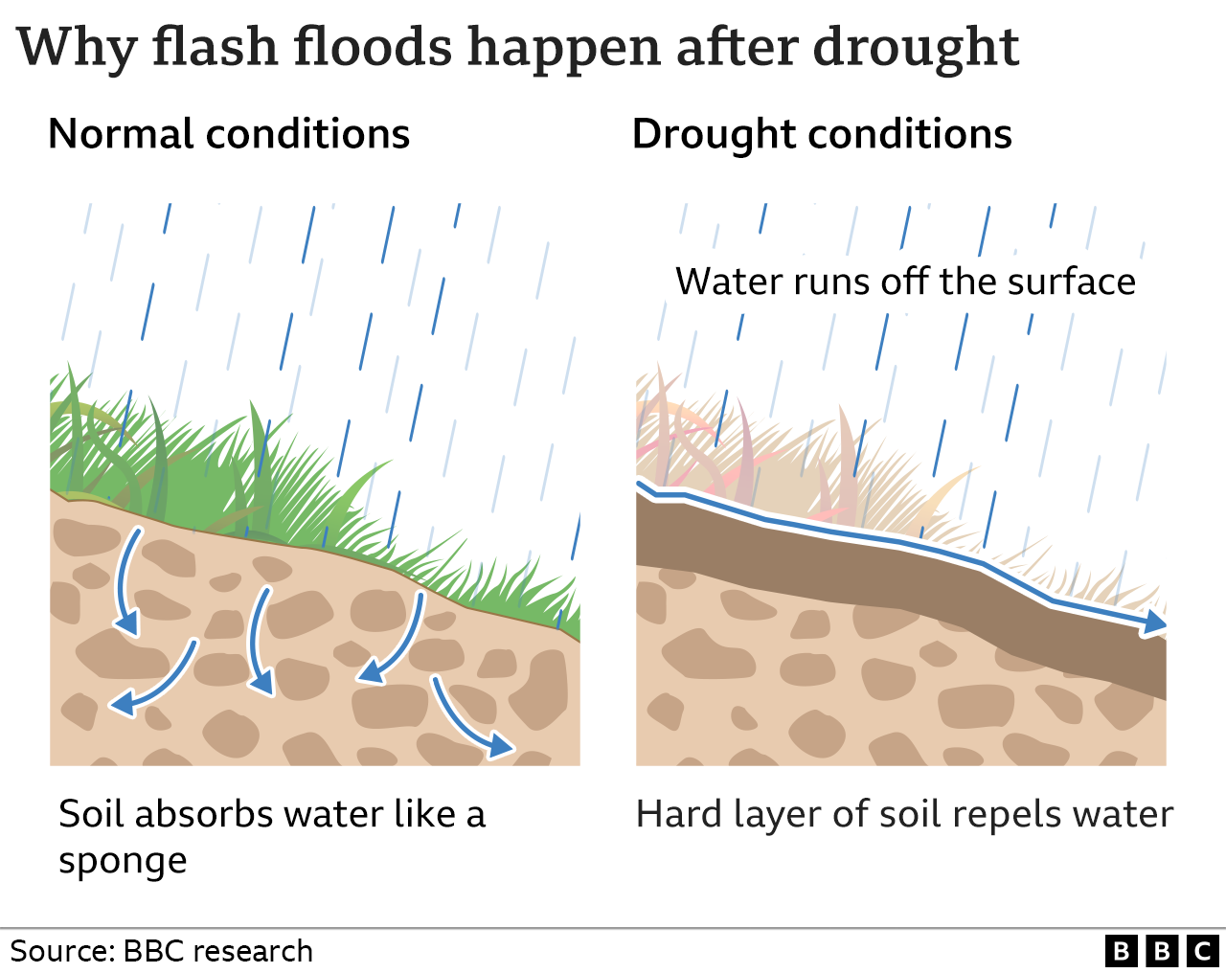
Soil drying
When the soil is dry, it becomes hard and compacted, which creates an impermeable layer on the surface losing its ability to retain water and becomes less porous. During heavy rainfall, the water runs off the surface increasing the risk of flooding.
9

Slide 21
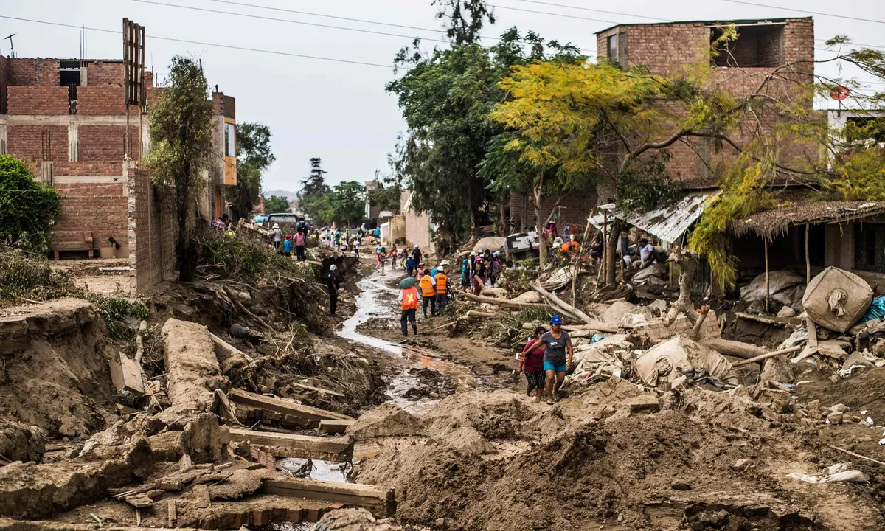
Infrastructure damage

Slide 22
Infrastructure damage
The primary effects of flooding include loss of life and damage to buildings and other structures, including bridges, sewerage systems, roadways, and canals. Floods also frequently damage power transmission and sometimes power generation, which then has knock-on effects caused by the loss of power. This includes loss of drinking water treatment and water supply, which may result in loss of drinking water or severe water contamination. It may also cause the loss of sewage disposal facilities. Damage to roads and transport infrastructure may make it difficult to mobilize aid to those affected or to provide emergency health treatment.
10

Slide 23
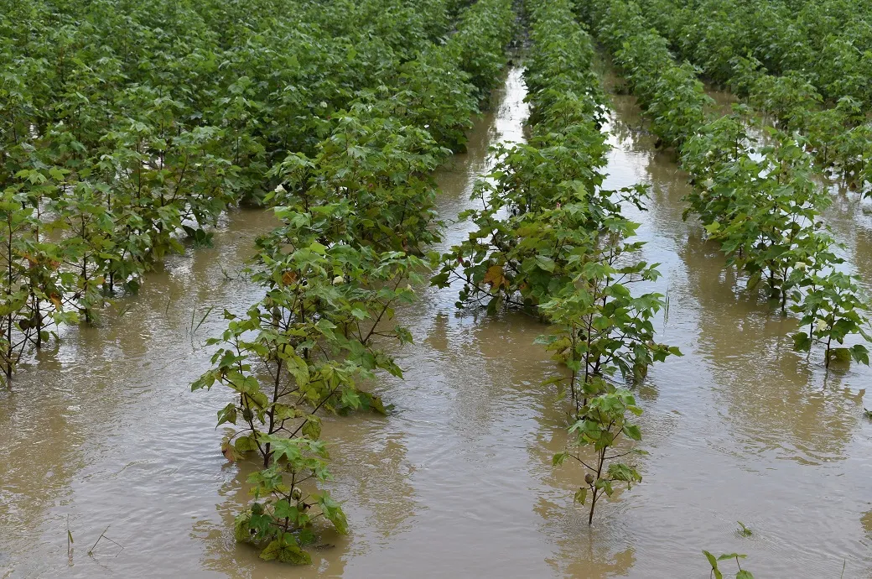
Decline in agriculture yield

Slide 24
Decline in agriculture yield
Floods have a significant impact on agriculture. They can damage crops by submerging fields, causing root rot, and depositing sediment. Soil erosion occurs as floodwaters wash away topsoil, leading to reduced fertility. Floodwaters may also contain agricultural land with pollutants and pathogens, making crops unsafe for consumption. Planting and harvesting are disrupted, resulting in reduced yields. Livestock can drown or suffer from stress-related diseases. Floods damage farm infrastructure and can have long-term effects on soil composition and farming sustainable city.
11

Slide 25
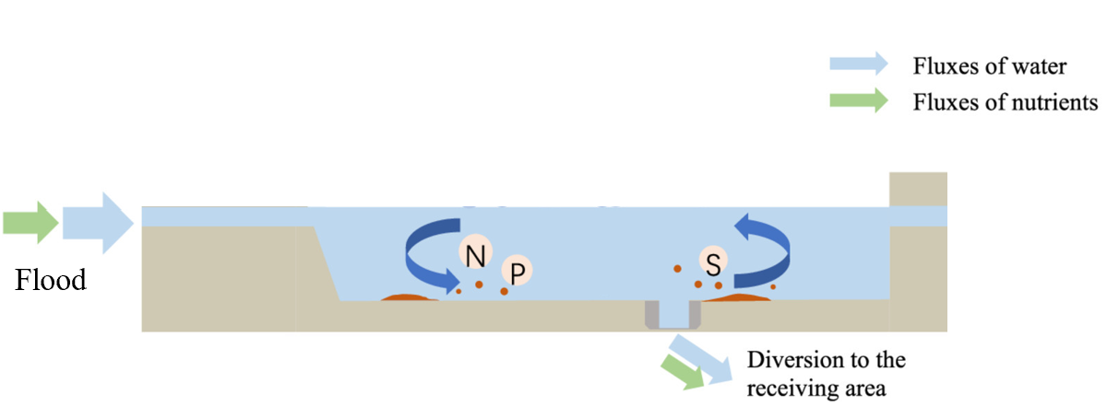
Increase of nutrients transport

Slide 26
Increase of nutrients transport
Floods (in particular more frequent or smaller floods) can also bring many benefits, such as recharging ground water, making soil more fertile and increasing nutrients in some soils. Flood waters provide much needed water resources in arid and semi-arid regions where precipitation can be very unevenly distributed throughout the year and kills pests in the farming land. Flooding can spread nutrients to lakes and rivers, which can lead to increased biomass and improved fisheries for a few years.
12

Slide 27
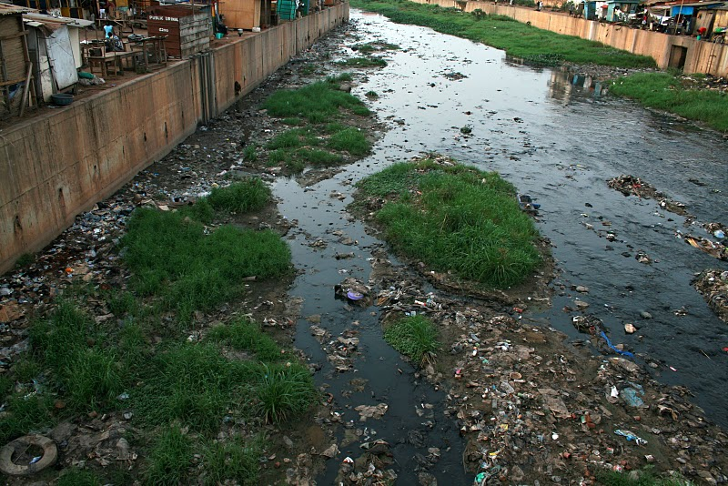
Drinking water shortage

Slide 28
Drinking water shortage
Due to the entrainment of a large amount of upstream domestic wastewater in the flood, the flood usually pollutes the downstream drinking water source. It makes the bacteria and viruses in the water multiply, and drinking the polluted water is easy to be infected with infectious diseases such as cholera.
13

Slide 29
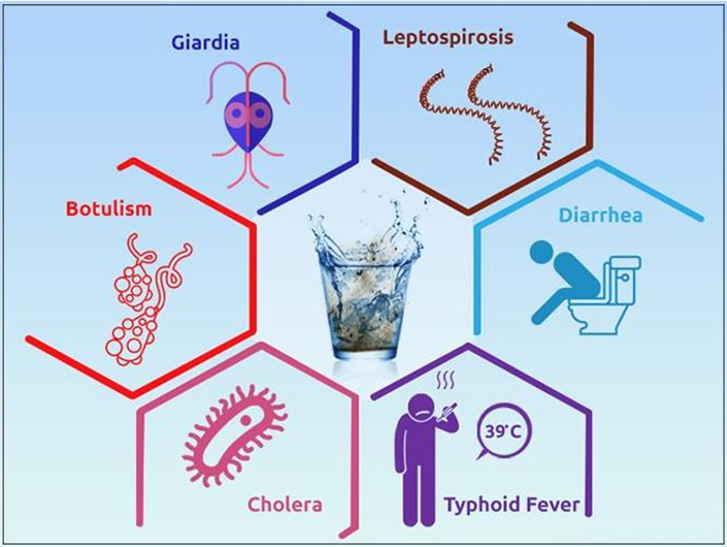
Waterbone diseases

Slide 30
Waterbone diseases
Floods often lead to epidemics of infectious diseases such as cholera. The 2004 South Asian tsunami was one of the worst flood disasters in modern times, killing about 280,000 people in eight countries in Asia and Africa. Drinking water sources have become contaminated, which has led to a massive spread of infectious diseases. Subsequent deaths from disease were nearly as many as the tsunami itself. Flooding causes rivers to overflow, and the resulting stagnant water can become a breeding ground for mosquitoes, making it easier for infectious diseases to spread. The floods resulted in deaths, and if these corpses were not properly disposed of in time, they could easily cause the spread of tuberculosis and blood-borne diseases.
14

Slide 31
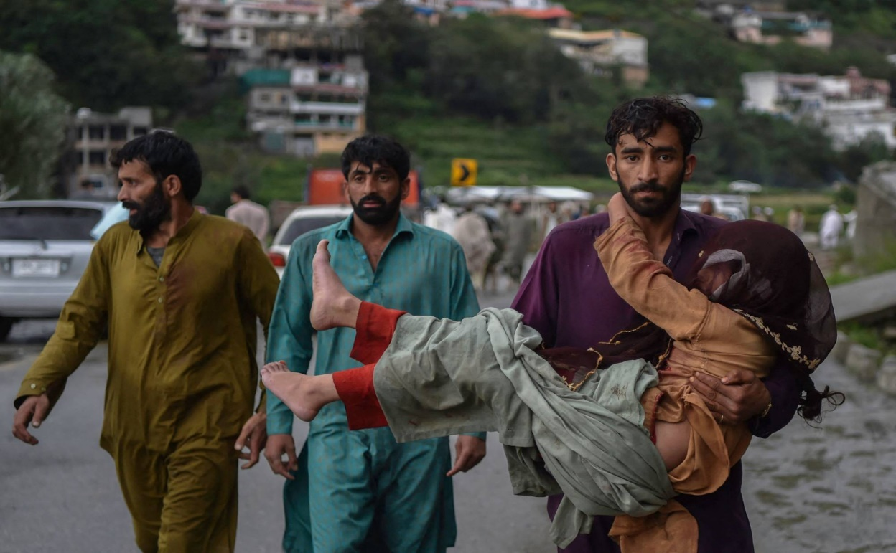
Loss of lives

Slide 32
Loss of lives
Floods can cause loss of lives in several ways. Drowning is a significant risk as rapidly rising floodwaters can engulf people, especially those attempting to cross flooded areas or trapped in vehicles. Structural collapse is another danger as floodwaters can weaken buildings, bridges, and infrastructure, leading to injuries and fatalities. Landslides triggered by heavy rainfall associated with floods can bury individuals under debris. Electrocution is a risk when floodwaters come into contact with electrical infrastructure. Contaminated water poses a threat, as floods can introduce sewage, chemicals, and pathogens, causing waterborne diseases. Displacement, exposure to harsh conditions, and inadequate access to necessities can also contribute to casualties.
15

